Slide 1

Strategic Plan Document Formatting
H401: Strategic Planning in Healthcare Organizations
Steven B. Reed, FACHE, Lecturer
www.pbhealth.iupui.edu

Slide 2
Example of Strategic Plan Document Formatting
The following represents an example for strategic plan document
formatting. There are a multitude of various formats that can be
used in constructing and collating a strategic plan document. The
goal is to present the data and information in a professional,
visually-attractive and easy-to-recognize manner so the reader can
easily understand the organization’s story, its future vision and
priorities, and the information that is being presented.
The following is being presented strictly for educational purposes.
The information presented is incomplete and is being presented
for purposes of providing an example of formatting only.

Slide 3

Strategic Plan Document
Formatting Examples

Slide 4
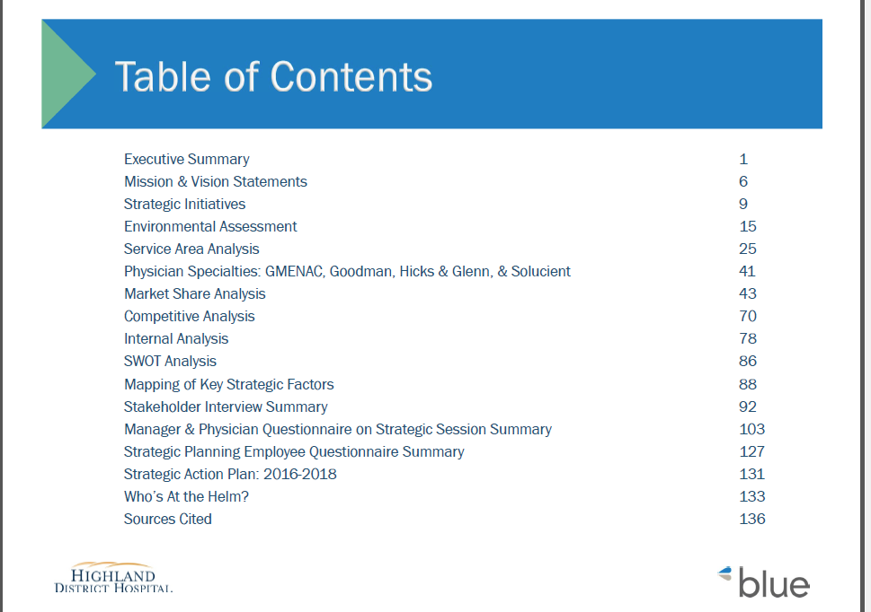

Slide 5


Slide 6

There are more objectives than these. This is an example of formatting.

Slide 7
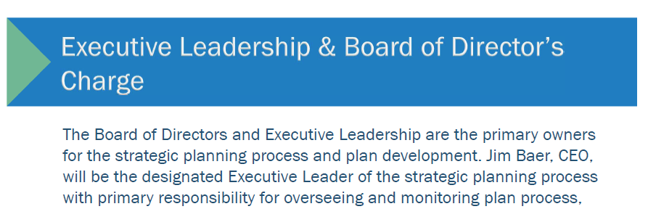
More can be written. This is an example of formatting.

Slide 8

More can be written. This is an example of formatting.

Slide 9

More can be written. This is an example of formatting.

Slide 10

More can be written. This is an example of formatting.

Slide 11


Slide 12

More initiatives should be included. This is an example of formatting.

Slide 13


Slide 14


Slide 15


Slide 16


Slide 17


Slide 18
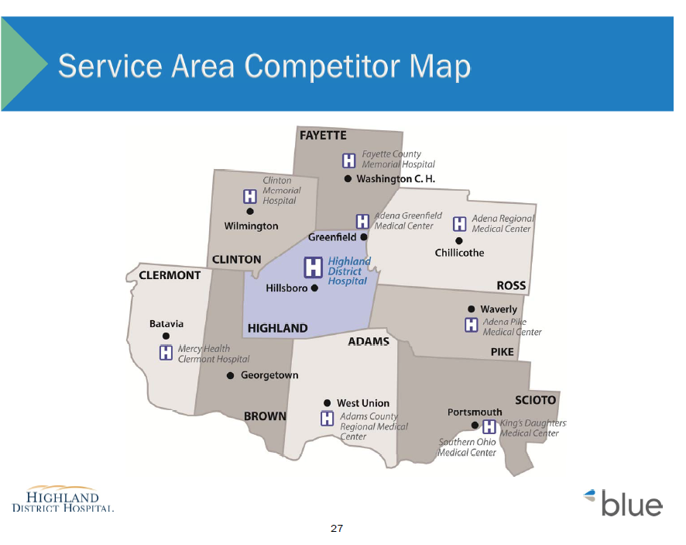

Slide 19
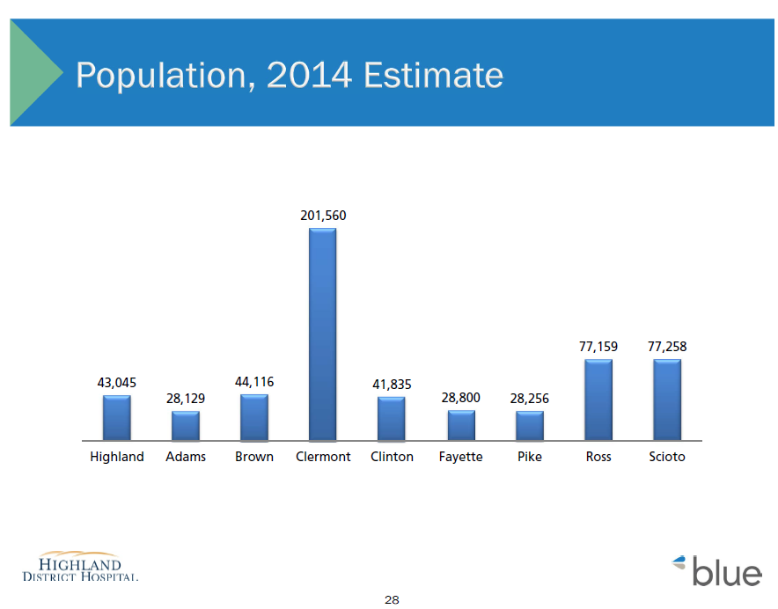

Slide 20


Slide 21
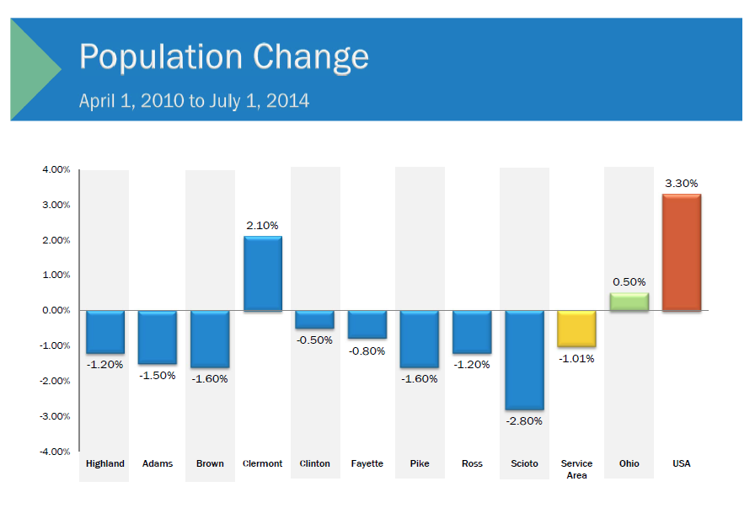

Slide 22
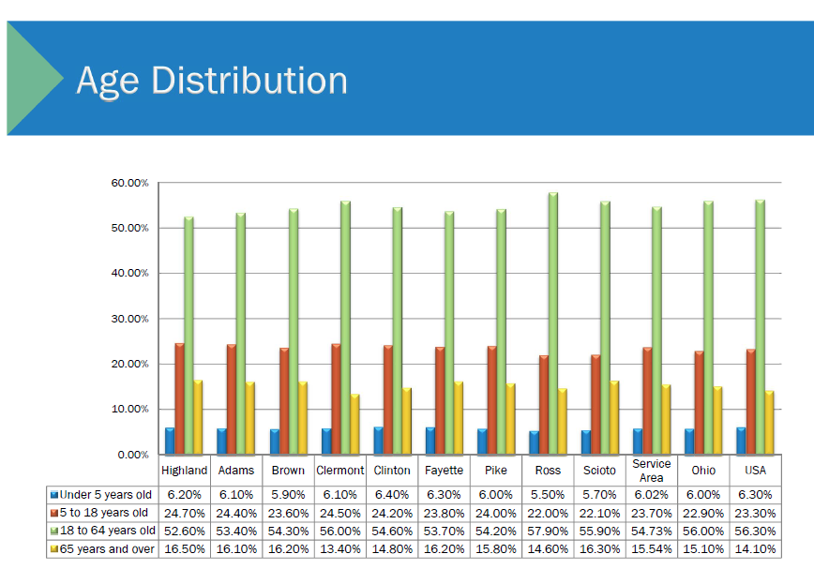

Slide 23
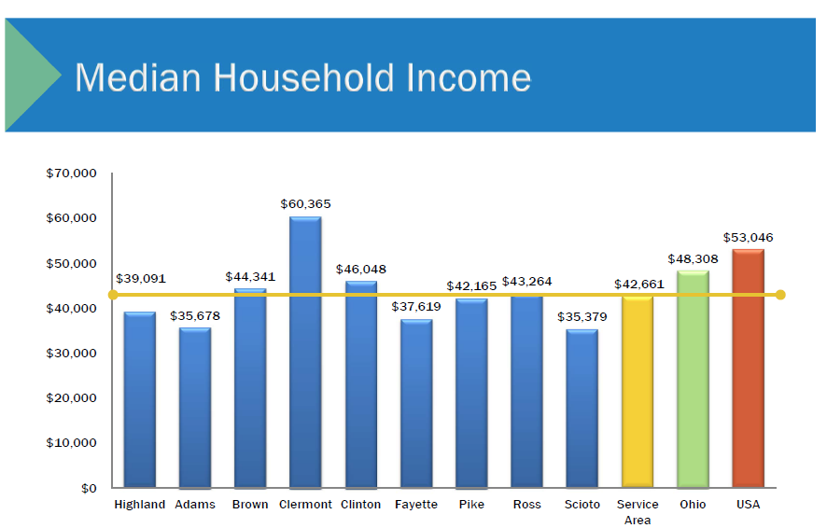

Slide 24


Slide 25
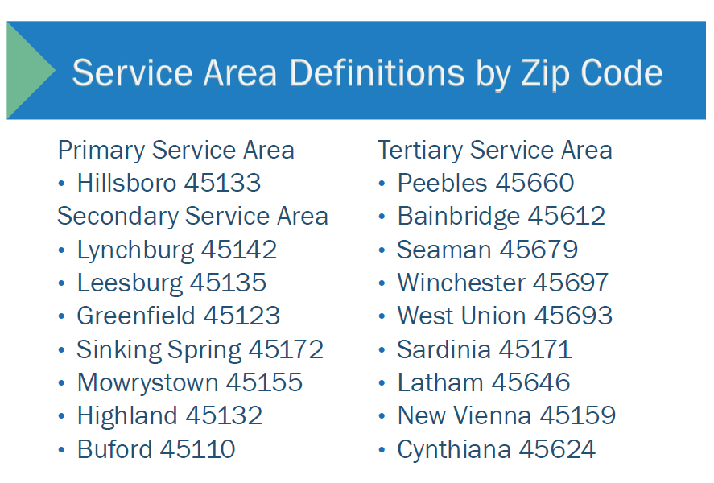

Slide 26

More can be written. This is an example of formatting.

Slide 27


Slide 28

More can be written. This is an example of formatting.

Slide 29


Slide 30


Slide 31


Slide 32
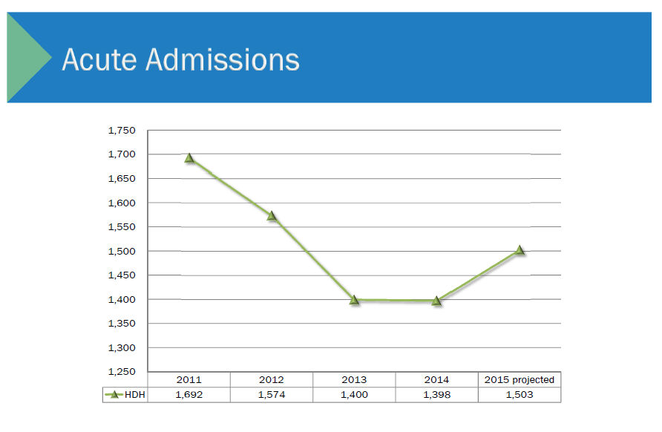

Slide 33
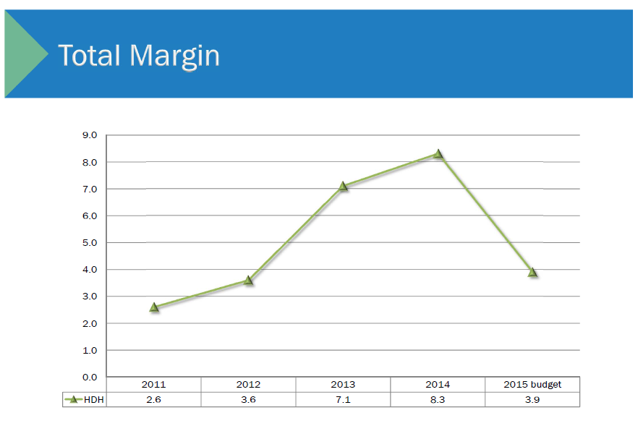

Slide 34
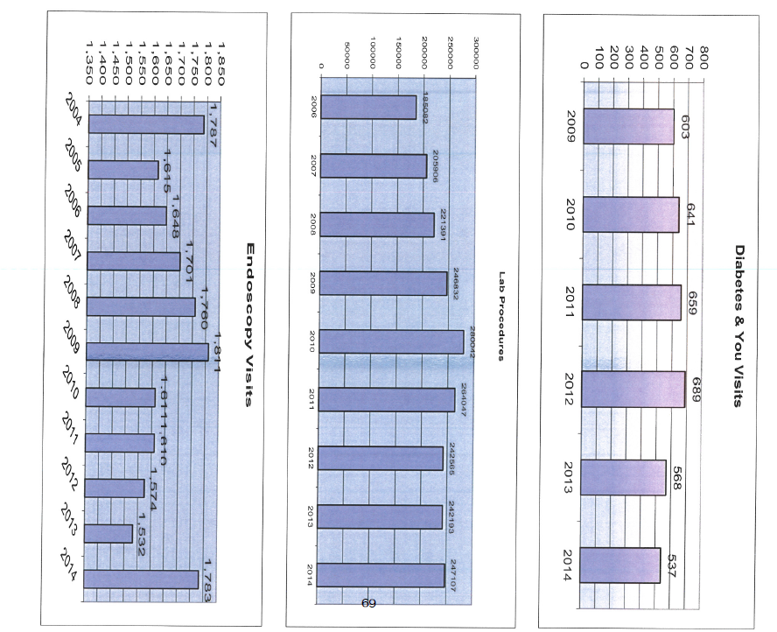

Slide 35


Slide 36




SWOT ANALYSIS
INTERNAL
POSITIVE
NEGATIVE
EXTERNAL

Slide 37


Slide 38
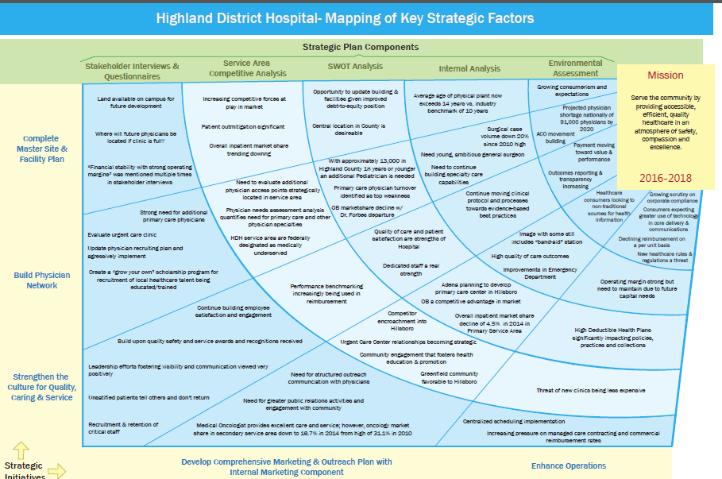

Slide 39


Slide 40
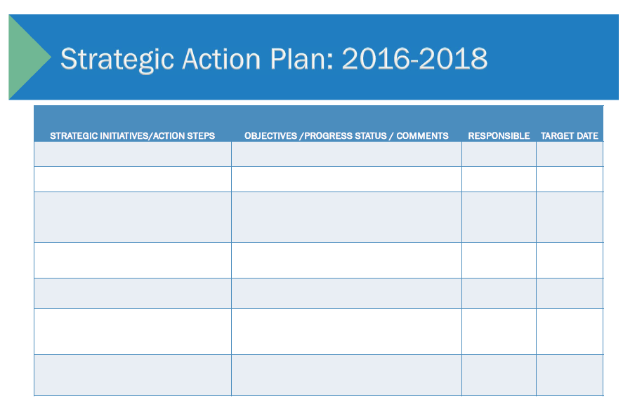

Slide 41


Slide 42


Slide 43
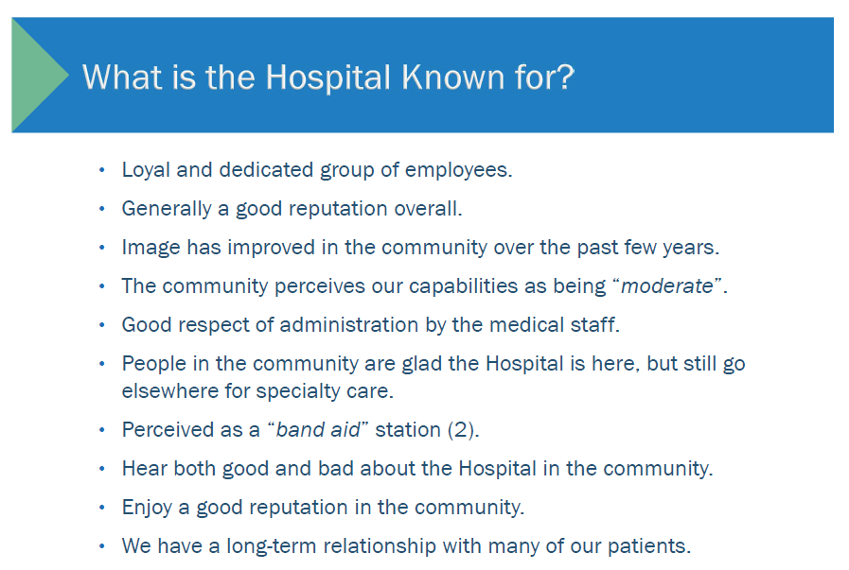
More can be written. This is an example of formatting.

Slide 44
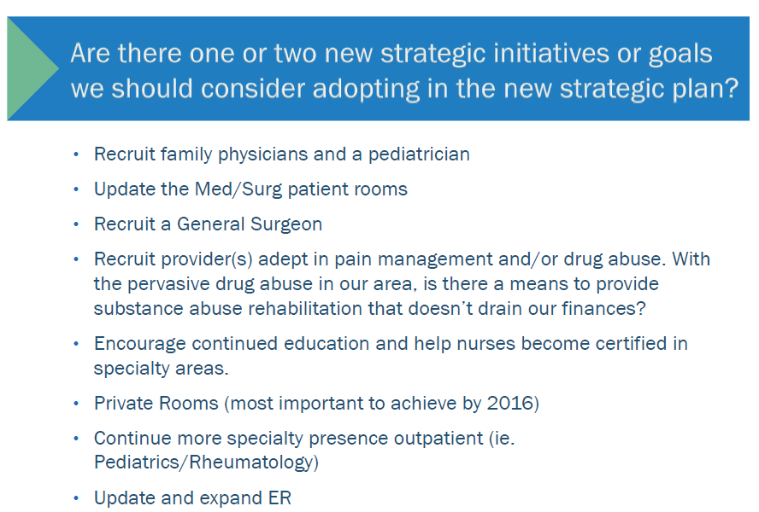
More can be written. This is an example of formatting.

Slide 45


Slide 46


